Slide 1
Space Weather Enterprise Forum 2011
Air Force Weather Activities
Col John Egentowich
AF Deputy Director of Weather
21 Jun 2011
Approved for Public Release – Distribution Unlimited

Slide 2
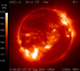
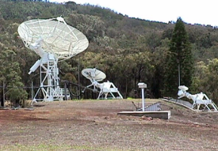







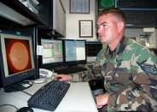




DoD Space Weather Services
AF Weather: 40+ Years Providing Space Wx for DoD Warfighters
Environmental Inputs
(DoD, Civil, International)
AFWA – weather data ingest/analysis/prediction & products to the warfighter!
Observations
Requirements
Data Received
Space /
Space Wx
Operators
Data & Products
Provided
Key Partnership
SWPC
AFWA: Space Wx
provider for DoD
Teamwork
2 Weather Squadron
Space Weather Flight

Slide 3

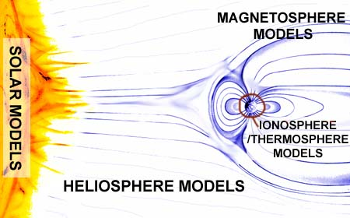






Partnerships
Our partner in operations
Collaboration with the Community Coordinated Modeling Center (CCMC): Integrated Space Wx Analysis (iSWA)
  User-friendly data / model displays
  Model Comparisons / Validation
  “Ensemble” displays
DoD Partners: AF Research Lab, AF Space Command, Space & Missile Systems Center, Electronic Systems Ctr, Naval Research Lab

Slide 4
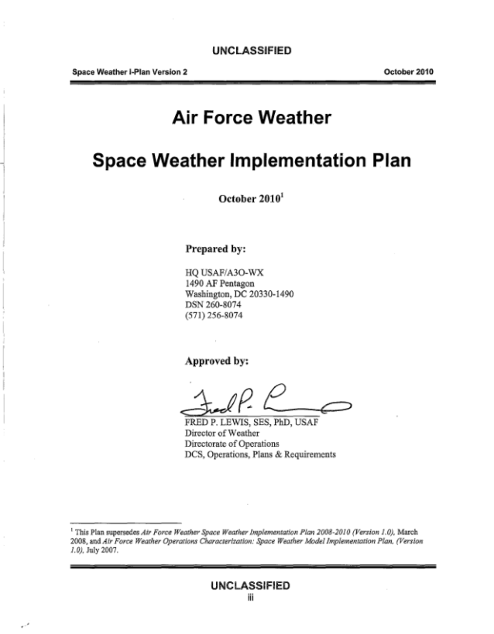
AF Weather Space Weather Implementation Plan
Priorities for improving Air Force Weather’s ground-based space environment sensing capability over next 5 years
Priorities for improving analysis and forecast capability

Slide 5
Investing in a Global Solar
Observing Network
BIG BEAR
SAGAMORE HILL
SAN VITO
KAENA
POINT
KIRTLAND
TEIDE
UDAIPUR
MAUNA LOA
LEARMONTH
CERRO TOLOLO
SOON / RADIO
SOON ONLY
Radio Solar Telescope Network
Upgrades finished in 2014
RSTN (RADIO) ONLY
RESEARCH ISOON
Solar Optical Observing Network
Upgrades finished in 2016
GONG

Slide 6
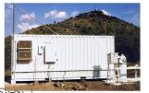
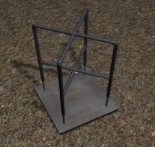
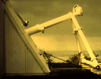
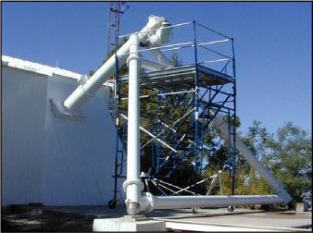
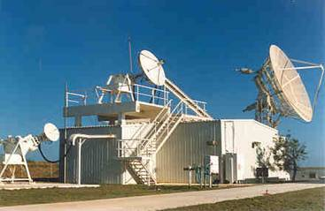
Space Weather
Ground-Based Sensing Initiatives
  Replace the Digital Ionospheric Sounding System (DISS) with the Next Generation Ionosonde (NEXION)—13 sites by end of 2012
  Upgrade the Radio Solar Telescope Network (RSTN) with remote operations—4 sites by end of 2014
  Upgrade the Solar Optical Observing Network (SOON) with new optics and remote operations—4 sites by end of 2016
  Partner with the Global Oscillation Network Group (GONG) to employ optical flare patrol data during SOON upgrades
GONG
DISS
RSTN
NEXION
SOON
SOON Upgrade

Slide 7
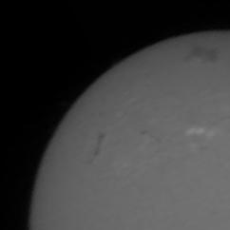
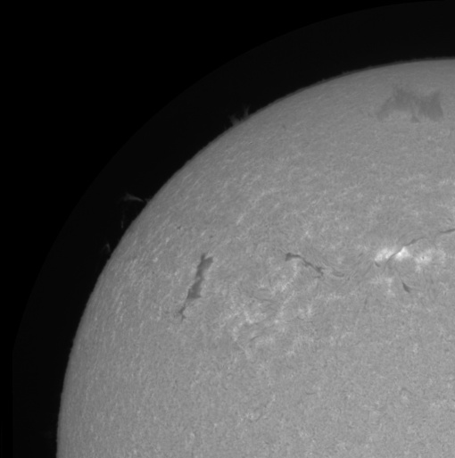
Improved
Optical Observations
SOON and SOON Upgrade
08 Apr 2010
Partners: AFRL, SMC
SOON
Hα 14:29UT
SOON Upgrade

Slide 8
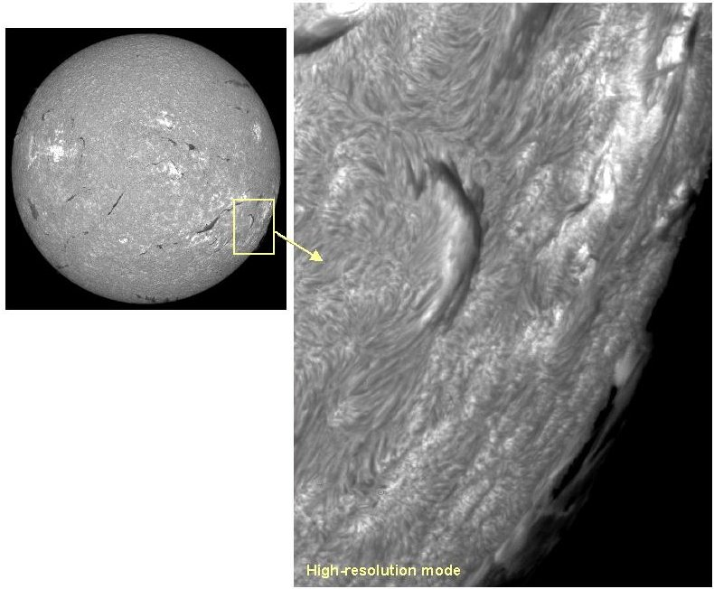
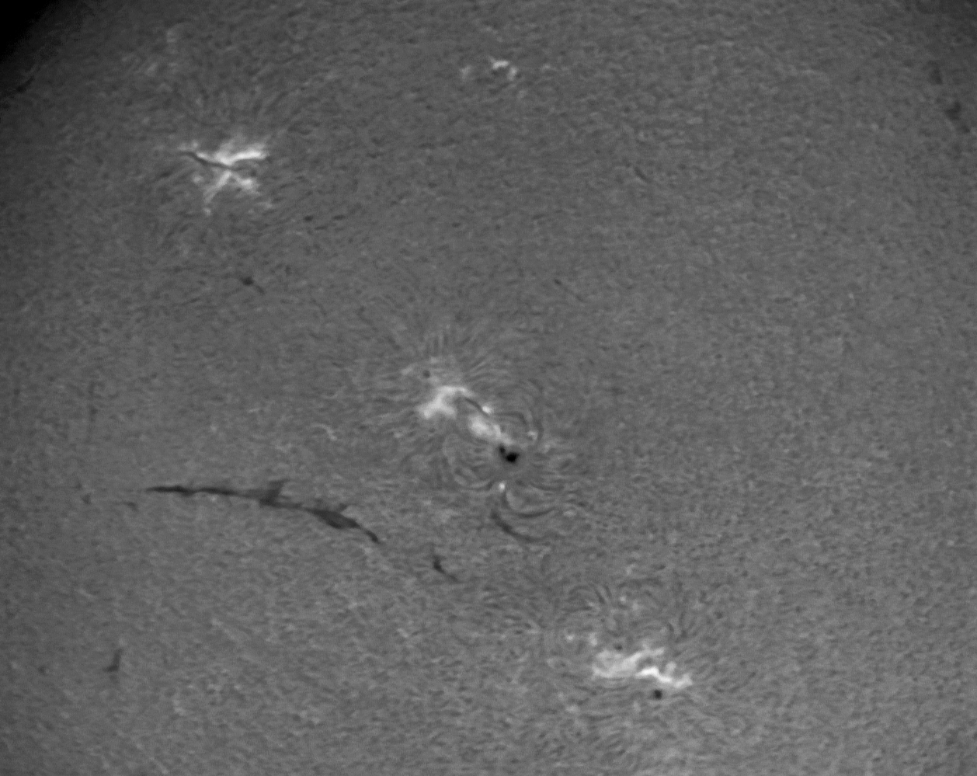
SOON – GONG
Operational Integration
SOON Upgrade
GONG
Upgraded Mar 11 to provide optical observation capability to AFWA
6-site network flare patrol during gaps in SOON coverage
Feb 12: Integrate GONG data into AFWA analysis & forecast system
Remote operation will collocate solar analysts with space weather forecasters

Slide 9
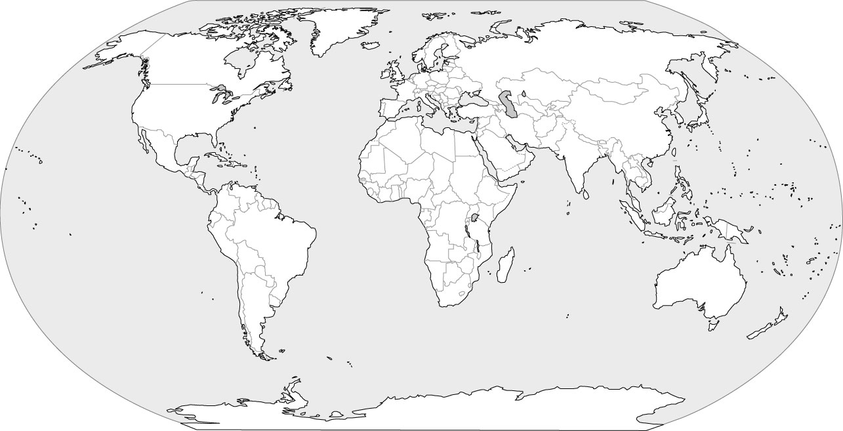
NEXION Fielding
Thule
Eielson
Goose
Bay
Fairford
Adak
Selfridge
ANG
San
Vito
Kazakhstan
Azores
Incirlik
Vandenberg
Canary Island
France
Osan
Kadena
Eglin
Greece
Bahrain
Kwajalein
Hawaii
Puerto Rico
Philippines
Soto Cano
Guam
Djibouti
French Guiana
Singapore
Fr. Poly
Ascension Island
Diego Garcia
Learmonth
Fielded (3)
Awaiting comm (2)
Remaining DISS (5)
Sites 11- 30

Slide 10
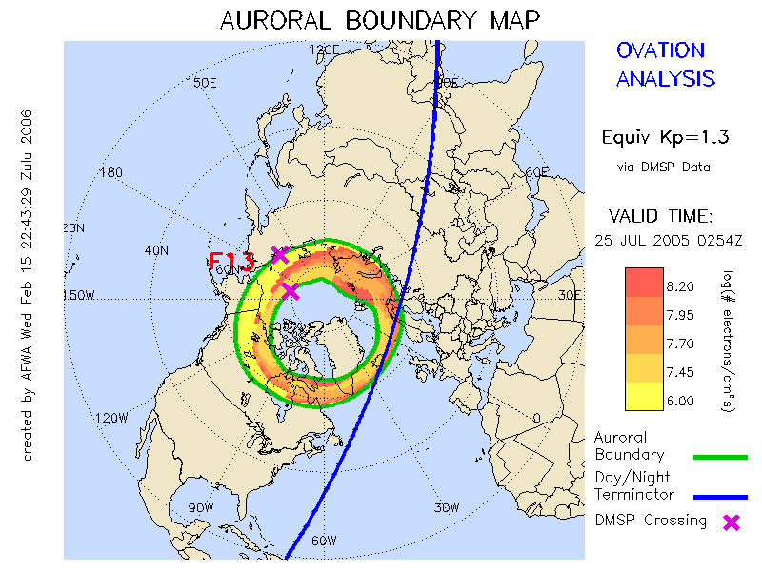
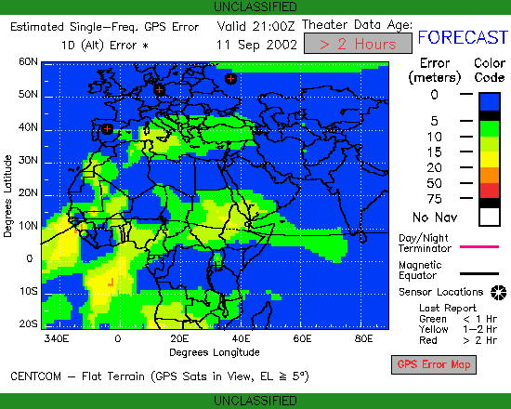
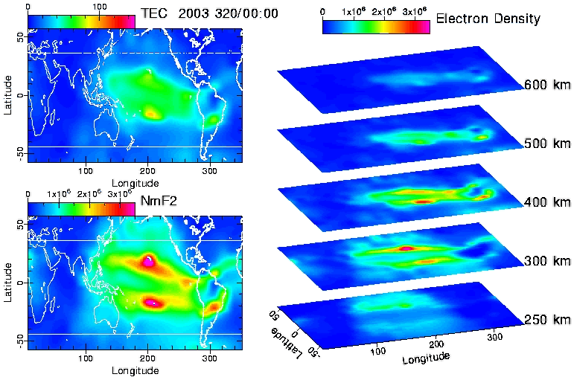
Space Weather Analysis and Forecast System
(SWAFS)
Jul 11 (Maintenance Release)
Incorporate NEXION data as sites come online
Add key automated problem alerts (Tivoli)
Aug 11
GAIM Block F—includes radio occultation data
JMSESS modifications – resolve missing/late Wing Kp data issues with SWPC
Magnetospheric Specification & Forecast Model (MSFM) modifications – reduce start-up time
H/W Upgrade (Sun to HP Blade architecture)
Sep/Oct 11
Incorporate SCINDA data from 4 new sites
Add ionosonde data from new NEXION sites
  Partners: NRL / AFRL/ SMC / Utah St & academia / CCMC

Slide 11
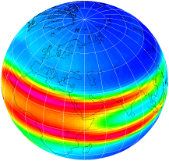
Ionospheric Modeling
Global Assimilation of Ionospheric Measurements (GAIM) Model
  Provides 24 hour forecast of ionospheric conditions
  Output used for high frequency communication and geolocation error analysis
Upgrades:
  Mar 12 upgrade: incorporation of COSMIC radio occultation data
  Follow-on “full physics” upgrade operational 2012-2013
Example output of ionospheric total electron content (TEC)

Slide 12
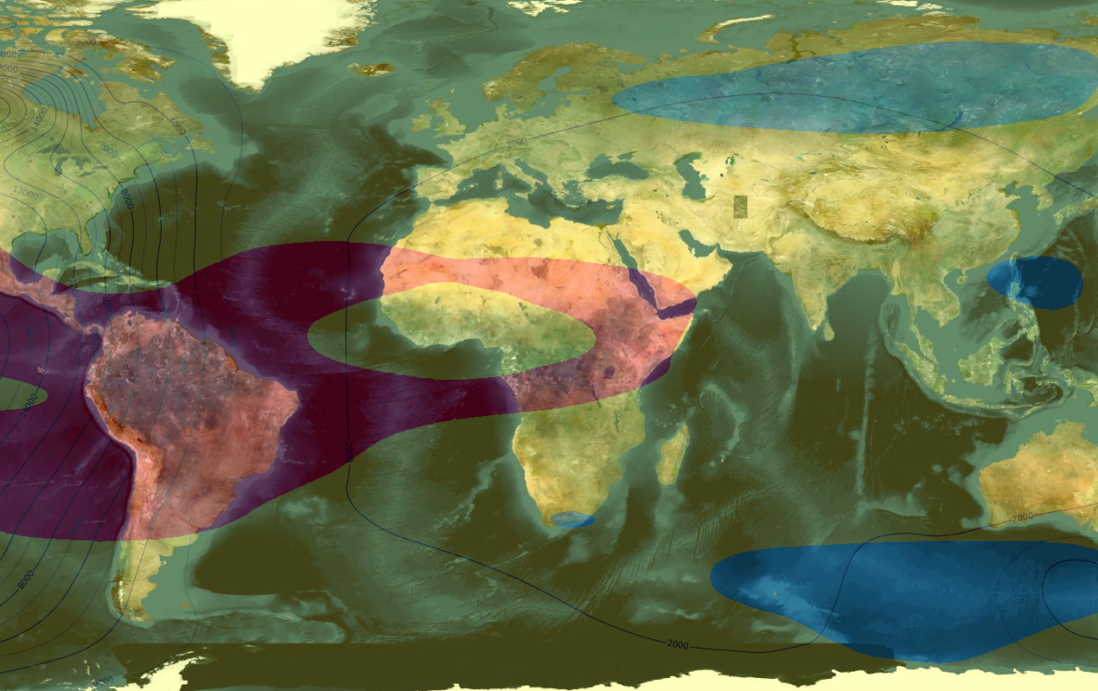
AFW-WEBS
Space weather products in a GIS/Google Earth format

Slide 13
Space Weather Mission Support
Way Ahead
Continue to team for solar max … and beyond
  Plans in place to improve collection, forecasting, & exploitation
  OFCM, NOAA, NASA, DoD, and other national partners working to determine optimum way forward
  Collaborate with U.S. & allied government/civilian agencies to increase sensing capability & reduce costs… NASA, NOAA, NSF, USGS, LANL, and others
Invest in collection…
  Modernize ground- and space-based sensing capabilities
Support national space weather forecasting needs
  Physics-based forecasting
Ensure exploitation of space weather expertise for space situational awareness into the future
  Tailor products to specific missions and operational needs
  Develop expertise/knowledge among operators and space weather professionals
Team, Sense, Forecast, and Exploit…the Way Forward

Slide 14
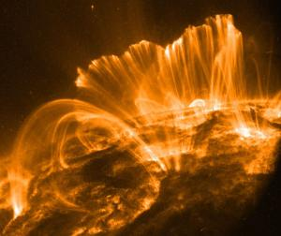
Questions?
Working with National Partners
to support National Space Weather needs
Rising Sun Over Pyramid (painting) – Paul Greco, 2009

